Slide 1
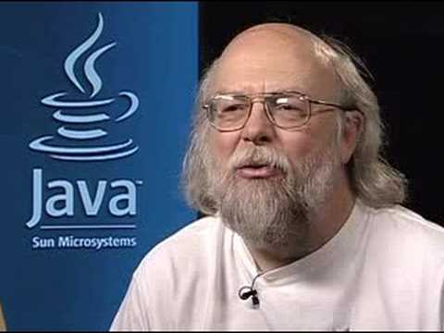
James Gosling Father of Java

Slide 2
Legal and illegal identifiers
int _a;
int $c;
int :b;
int -d;
int ______2_w;
int e#;
int _$;
int .f;
int 7g;

Slide 3


Legal and illegal Identifiers
int _a;
int $c;
int :b;
int -d;
int ______2_w;
int e#;
int _$;
int .f;
int 7g;

Slide 4
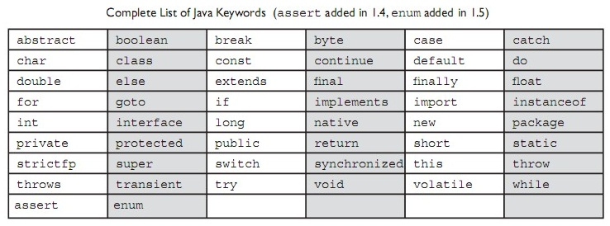
Java Keywords

Slide 5
Which one of the following is invalid declarations of a char ?
char c1 = 064770;
char c2 = ‘cdac';
char c3 = 0xcdac;
char c6 = '\ucdac';

Slide 6
Which three are valid declarations of a float?
float f1 = -343;
float f2 = 3.14;
float f3 = 0x12345;
float f4 = 42e7;
float f5 = 2001.0D;
float f6 = 2.81F;

Slide 7
Output?
class Equals {
public static void main(String [] args) {
int x = 100;
double y = 100.1;
boolean b = (x = y);
System.out.println(b);
}
}

Slide 8
Octal variable
class OctalPrgm
{
public static void main(String[] args)
{
int i=07;
System.out.println(++i);
i=i+1;
System.out.println(++i);
}
}
A. 00
01
B. 8
9
C: 8
10
D: Compile time error

Slide 9
Method Example
class MyClass
{
public static void main(String[] args)
{
int x;
x=test();
System.out.println("x="+x);
}
static int test()
{
System.out.println("Inside Test()");
}
}
A.Inside Test()
x=0
B.Compilation Error
C.None of the Above

Slide 10
Output?
class Test{
public static void main(String args[]){
int i = (int)(char)(byte) -2;
System.out.println(“Output : ”+i);
}
}

Slide 11
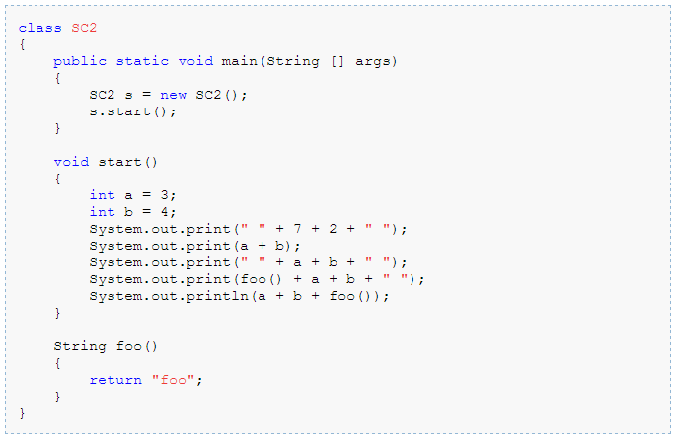
Output?

Slide 12
Output?
class Test{
public static void main(){
go();
}
static void go(){
System.out.println(“Go”);
}
}

Slide 13
Shadowing
class Test{
static int num = 7;
static void incrementNumber(int num){
num++;
System.out.println(num);
}
public static void main(String args[]){
System.out.println(num);
incrementNumber(num);
System.out.println(num);
}
}

Slide 14
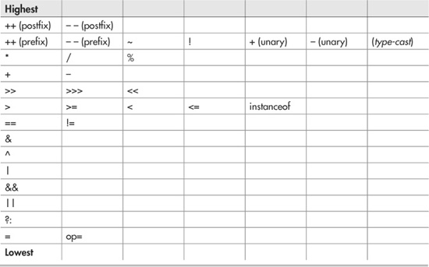
Precedence Of Operators

Slide 15
Operators Example
class Operators1
{
public static void main(String[] args)
{
int x =5;
x *= 2 +5;
System.out.println(x);
}
}
A.15
B.35
C.Compilation Error
D.None of the Above

Slide 16
public class ForLoop
{
public static void main(String[] args)
{
for(int i=0;i>4?false:true;i++)
{
System.out.println("i="+i);
}
}
}
A.i=0
i=1
i=2
i=3
i=4
B.i=0
i=1
i=2
i=3
C.Compilation Error
D.prints nothing

Slide 17
Switch example 1
int b = 10;
switch(b){
case 1 : System.out.println(“1”); break;
case 5 : System.out.println(“5”); break;
case 10 : System.out.println(“10”); break;
default : System.out.println(“default”); break;
}

Slide 18
Switch example 2
int b = 10;
switch(b){
case 1 : System.out.println(“1”); break;
case 10 : System.out.println(“10”);
case 5 : System.out.println(“5”);
default : System.out.println(“default”); break;
}

Slide 19
Switch example 3
int b = 10;
switch(b){
default : System.out.println(“default”);
case 1 : System.out.println(“1”);
case 5 : System.out.println(“5”);
case 10 : System.out.println(“10”);
}

Slide 20
Output?
class Test{
public static void main(String args[]){
go();
}
void go(){
System.out.println(“Go”);
}
}

Slide 21
Output?
class Test{
public static void main(String args[]){
new Test().go();
}
void go(){
System.out.println(“Go”);
}
}

